Slide 1
Chapter: Protection and Security

Slide 2
Objectives
Discuss the goals and principles of protection in a modern computer system
Explain how protection domains combined with an access matrix are used to specify the resources a process may access
Examine capability and language-based protection systems

Slide 3
Goals of Protection
Process in OS must be protected from the one another.
Protection refers to a mechanism for controlling the access of the programs, processes or users to the resources defined by the computer system.
Protection improves reliability.
Protection Mechanism determine: how some thing will be done
Policy determine: what is to be done.
Protection refers to a mechanism for controlling the access of programs, processes, or users to the resources defined by a computer system.
This mechanism must provide a means for specifying the controls to be imposed, together with a means of enforcement.

Slide 4
Protection in Computer System
System with Contiguous memory allocation:
  Protection is achieved by Use of Limit Registers
In Paging System:
  Protection is achieved by use of Page Table. Each process has its own page table.
In System with Segmentation:
  Protection is achieved by Use of Segment Table – Each table is protected by base address and limit register
In System with files stored on Secondary Storage:
  Protection is achieved by Access Rights

Slide 5
Access Control
Method that determines:
  What types of access are permitted on different resources
  Under what circumstances
  By Whom

Slide 6
Access Control
Access Control Model has 3 basic components:
  Subjects (S) or Domain: Represents a finite set of entities that have access to current object.
    Subject may be: User , Process or Procedure
  Objects (O): Represents a finite set of resources that need access.
    Object may be: H/w device ( processor, memory) Or S/W resources ( page table, files etc)
  Rights ( R): Represents a finite set of Operations that a Subject can perform on Object.

Slide 7
Access Control Policies
Protection Domain: is a collection of objects and access rights (Permissions –rwx-)
Discretionary Access Control
  In this model, Each object is owned by some subject/domain and Owner of the object decides which what kind of access rights are there.
Mandatory Access Control
  System Administrator enforce a policy for all users.
Role-Based Access Control
  Access control is based on roles that users have within the system

Slide 8
Discretionary Access Control/ Access Matrix
Discretionary Access Control Model is represented by Access Matrix.
It is used to describe which users have access to what objects or resources.
Access Matrix consists of Rows and Columns
Rows represent : Current Subject / Domain
Column represent: Current Object

Slide 9
Discretionary Access Control/ Access Matrix
View protection as a matrix (access matrix)
Rows represent domains
Columns represent objects
Access(i, j) is the set of operations that a process executing in Domain_{i} can invoke on Object_{j}

Slide 10

Access Matrix

Slide 11
Use of Access Matrix
If a process in Domain D_{i} tries to do “op” on object O_{j}, then “op” must be written in the access matrix
Can be expanded to dynamic protection
  Operations to add, delete access rights
  Special access rights:
    owner of O_{i}
    copy op from O_{i} to O_{j}
    control – D_{i} can modify D_{j} access rights
    transfer – switch from domain D_{i} to D_{j}

Slide 12
Use of Access Matrix (Cont)
Access matrix design separates mechanism from policy
  Mechanism (Method)
    Operating system provides access-matrix + rules
    If ensures that the matrix is only manipulated by authorized agents and that rules are strictly enforced
  Policy (Rules)
    User dictates policy
    Who can access what object and in what mode

Slide 13
Implementation of Access Matrix
There are 2 methods:
1. Access Control Lists
  ACL can be created by dividing Access Matrix Column Wise.
  Separate list is maintained for each domain and each object.
  It skips blank row entries in each domain.
2. Capability List
  Can be created by dividing Access Matrix Row Wise.
  It is list of access rights that a user / domain or a process has for a object.
  It is divided into 2 fields:
    Object Descriptor
    Access Rights

Slide 14
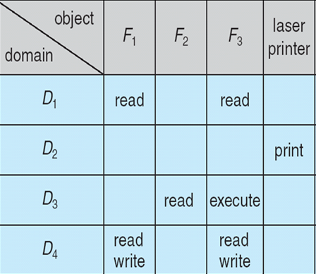
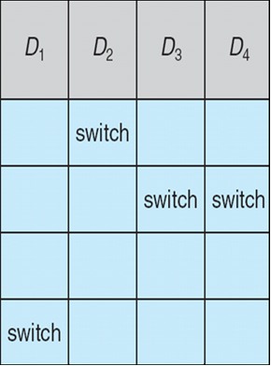
Access Matrix With Domains as Objects
Figure B

Slide 15

Operation on Access Matrix Entries
1. Copy
  It allows the access right to be copied only within the column (for an object)
  Ability to copy an access right from one domain (row) to another is denoted by asterisk ( * )
  A process executing in domain D2 can copy read operation into any entry associated with file F2
  The ability to copy rights is denoted by an asterisk, indicating that processes in that domain have the right to copy that access within the same column

Slide 16
Access Matrix with Copy Rights
For example, in Figure
(a), a process executing in domain D2 can copy the read operation into any entry associated with file F2.
Hence, the access matrix of Figure (a) can be modified to the access matrix shown in Figure(b).

Slide 17
Operation on Access Matrix Entries
2. Owner
  It allows addition or removal of access rights.
  If any access includes owner right then a process executing in domain Di can add or remove any access right in entry of that column.
Copy and Owner allow a process to change the entry in column.
If access(i, j) includes the owner’s right, then a process executing in domain Di can add and remove any right in any entry in column j.

Slide 18
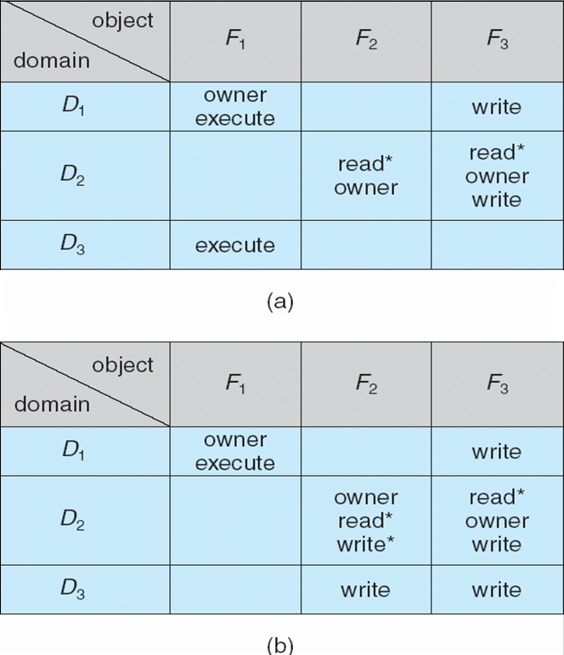
Access Matrix With Owner Rights
For example, in Figure (a), domain D1 is the owner of F1 and thus can add and delete any valid right in column F1.
Similarly, domain D2 owns F2 and F3 and thus can add and remove
any valid right within these two columns. Thus, the access matrix of Figure
(a) can be modified to the access matrix shown in Figure (b).

Slide 19

Operation on Access Matrix Entries
3. Control Right
  Control right mechanism used to change entries in a row.
  Control right is applicable only to domain objects.
  If access( i , j ) includes control right, then a process executing in domain Di can remove any access right from row j.
  Switch operation works for column only
For example, suppose that, we include the control right in access(D2, D4). Then, a process executing in domain D2 could modify domain D4, as shown.

Slide 20
Operation on Access Matrix Entries
3. Control Right
For example, suppose we include the control right in access(D2, D4). Then, a process executing in domain D2 could modify domain D4, as shown.

Slide 21
Implementation of Access Matrix
1. GLOBAL TABLE:
Global Table consisting of a ordered set of triples <domain, object, right set>
Before every operation on any object in any domain, the global table is searched for triple.
  If a triple is found, the operation is allowed to continue, otherwise, an exception or error condition is raised.
Drawbacks:
Table is large. Can not be kept in the main memory. So additional I/O is needed.
2. ACCESS LISTS FOR OBJECTS:
Each column can be implemented as an access list.
Resultant list consists of: <domain, right sets>an

Slide 22
Security
Method of protecting information stored in the system from un-authorized access.
Security must consider external environment of the system, and protect it from:
  unauthorized access.
  malicious modification or destruction
  accidental introduction of inconsistency.
Security violation can be categorized as intentional or accidental.
Security is a measure of confidence that the integrity of a system and its data will be preserved.

Slide 23
Some Security Violations
Breach of Confidentiality: Unauthorized reading of data. Theft of information
Breach of integrity: Unauthorized modification of data.
Breach of availability: Unauthorized destruction of data/ website defacement:
A website defacement is an attack on a website that changes the visual appearance of the site or a webpage.
Theft of service: Unauthorized use of resources.
Denial of service: Send invalid data to applications or network services, which cause abnormal termination.
Flood a computer or the entire network with traffic until a shutdown occurs because of the overload.

Slide 24
Security Measure Levels
To protect our system, we must take security measures at 4 levels:
Physical - Secure Hardware Components
Human – Use Passwords for protection
Operating system – Use Valid Login and Password
Network – Use authentication and anti-virus to protect data/ resources over the network.

Slide 25
Program Threats
Writing a program that creates a breach of security or causing a normal process to change its behavior and create a breach is the common goal of crackers
Malware: A destructive program that pretend to be a gentle application.
A back door is a means of access to a computer program that bypasses security mechanisms.

Slide 26
Program Threats
1. Trojan horse
A Trojan horse, or Trojan, is software that appears to perform a desirable function for the user, but steals information or harms the system.
Trojan horse is a program in which harmful code is contained in such a way that it can get control and do its chosen form of damage

Slide 27
1. Trojan horse
Many systems have mechanisms for allowing programs written by some users to be executed by other users.
If these programs are executed in a domain that provides the access rights of the executing user, the other users may misuse these rights.
For example: A text-editor program, may include code to search the file to be edited for certain keywords. If any are found, the entire file may be copied to a special area accessible to the creator of the text editor.
A code segment that misuses its environment is called a Trojan horse.

Slide 28
1. Trojan horse
A variation of the Trojan horse is a program that emulates (copy) a login program.
An unsuspecting user starts to log in at a terminal and notices that he has apparently mistyped his password. He tries again and is successful.
What has happened is that his authentication key and password have been stolen by the login emulator, which was left running on the terminal by the thief.
The emulator stored away the password, printed out a login error message, and exited; the user was then provided with a genuine login prompt.

Slide 29
2. Spyware
A software that secretly monitors the user's computing.
Spyware is a type of malware that can be installed on computers, and which collects small pieces of information about users without their knowledge.
The presence of spyware is typically hidden from the user, and can be difficult to detect.
Sometimes, Spywares are installed by the owner of a shared, corporate, or public computer in order to secretly monitor other users.

Slide 30
2. Spyware
Spyware sometimes accompanies a program that the user has chosen to install.
The goal of spyware is to download ads to display on the user’s system, create pop-up browser windows when certain sites are visited, or capture information from the user’s system and return it to a central site.

Slide 31
3. Trap Door
The designer of a program or system might leave a hole in the software that only designer is capable of using. This type of security breach is called trap door.
For instance, the code might check for a specific user ID or password, and it might circumvent normal security procedures
A clever trap door could be included in a compiler. The compiler could generate standard object code as well as a trap door, regardless of the source code being compiled.

Slide 32
3. Trap Door
Trap doors pose a difficult problem because, to detect them we have to analyze all the source code for all components of a system.

Slide 33
4. Logic Bomb
Consider a program that initiates a security incident only under certain circumstances.
Under normal operations, there would be no security hole. However, when a predefined set of parameters was met, the security hole would be created. This scenario is known as a logic bomb.
for example, A programmer, might write code to detect whether he is still logged in if that check failed, a daemon could be generated to allow remote access, or code could be launched to cause damage to the site.

Slide 34
5. Stack and Buffer Overflow
The stack- or buffer-overflow attack is the most common way for an attacker outside the system, on a network or dial-up connection, to gain unauthorized access to the target system.
the attacker exploits a bug in a program. The bug can be a simple case of poor programming, in which the programmer neglected to code bounds checking on an input field. In this case, the attacker sends more data than the program was expecting.

Slide 35
6. VIRUS
VIRUS: Vital Information Resource Under Seize or Very Important Resource Under Seize
Fragment of malicious code embedded in a genuine program.
designed to “infect” other programs.
Specific to architecture, operating systems and applications.
Needs human intervention to move from host to host.
Needs some one to actually take that program from one device and run it onto other device
Does not self replicate itself

Slide 36
Main categories:
A VIRUS:
FILE: infects system by appending itself to a file. Changes start. Execution jumps to its code, returns control, executes unnoticed.
BOOT: infects boot sector, executing every time system is booted. Infects other bootable media(Floppy disks).
MACRO: these viruses are triggered when a program capable of executing the macro is run.
Source Code: looks for source code and modifies it to include the virus and to help spread the virus.
Polymorphic: this virus changes every time it is installed to avoid detection by antivirus software. Changes don’t change its functionality but change virus functionality.

Slide 37
Main categories:
A VIRUS:
Encrypted. An encrypted virus includes decryption code along with the encrypted virus, again to avoid detection. The virus first decrypts and then executes.
Stealth. This tricky virus attempts to avoid detection by modifying parts of the system that could be used to detect it. For example, it could modify the read system call so that if the file it has modified is read, the original form of the code is returned rather than the infected code.
Tunneling. This virus attempts to bypass detection by an antivirus scanner by installing itself in the interrupt-handler chain. Similar viruses install themselves in device drivers.

Slide 38
Main categories:
Multipartite Avirus of this type is able to infect multiple parts of a system,including boot sectors, memory, and files. This makes it difficult to detect and contain.
Armored. An armored virus is coded to make it hard for antivirus researchers to unravel and understand. It can also be compressed to avoid detection and disinfection. In addition, virus droppers and other full files that are part of a virus infestation are frequently hidden via file attributes or unviewable file names.

Slide 39
System and Network Threats
Program threats typically use a breakdown in the protection mechanisms of a system to attack programs.
System and network threats involve the abuse of services and network connections.
System and network threats create a situation in which operating-system resources and user files are misused.

Slide 40
1. Worms
Self propagating.
A worm is a process that uses the spawn mechanism to duplicate itself. The worm spawns copies of itself, using up system resources and perhaps locking out all other processes.
If a device gets infected, it sends the copies of itself onto the network to other devices.
Sometimes more disturbing, it might go into your email, find your contacts, sends copies of itself to all the contacts.

Slide 41
2. Port Scanning
Port scanning is not an attack but rather a means for a cracker to detect a system’s vulnerabilities (bug) to attack.

Slide 42
3. Denial of Service
denial-of-service attacks are aimed not at gaining information or stealing resources but rather at disrupting genuine use of a system or facility.
Denial-of-service attacks are generally network based.
They fall into two categories:
1. Attacks in the first category use so many facility resources that, in essence no useful work can be done.
2. The second category involves disrupting the network of the facility.

Slide 43
Authentication
Process of verifying the identity of user or information
1. User Authentication
  Process of verifying the identity of user when user logs into a computer system.
  Main Objective: Allow authorized users to access the computer.
  Authentication Process consists of 2 steps:
  Identification Step
  Verification Step

Slide 44
Measures of Authentication
False Acceptance Ratio: % of unauthorized users incorrectly entered the system
False Rejection Ratio: % of authorized users that fails to access the system due to failure of authentication.

Slide 45
General Methods of Authentication
Include a Password
Include electronic key or smart cards
Static Biometric – Recognition by finger print, retina or face.
Dynamic Biometric – Recognition by Voice, Handwriting or Typing Pattern.

Slide 46
Password Verification
Password Verification – Authentication Mechanism
Password- a secret text that is supposed to be known only to users.
System allows authorized users who have valid user name and password to access the system.

Slide 47
Threat Monitoring
Check for suspicious patterns of activity – several incorrect password attempts may signal password guessing.
Audit log – Check audit logs to see the time a user is trying to accesses an object
  Useful for recovery from a violation and developing better security measures.
Scan the system periodically for security holes; done when the computer is relatively unused.

Slide 48
Threat Monitoring (Cont.)
Check for:
  Short or easy-to-guess passwords
  Unauthorized set, user id’s
  Unauthorized programs in system directories
  Unexpected long-running processes
  Improper directory protections
  Improper protections on system data files
  Changes to system programs

Slide 49
FireWall
A firewall is a device or set of devices designed to allow or deny network transmissions based upon a set of rules.
Firewall is frequently used to protect networks from unauthorized access.
A firewall is placed between trusted and untrusted hosts.

Slide 50
Encryption
Encryption is the process of encoding messages or information in such a way that only authorized parties can read it
Plaintext: The original intelligible message
Cipher text: The transformed message

Slide 51
Encryption
Key: Information used by the cipher, known only to the sender& receiver
Encipher (encode) The process of converting plaintext to cipher text using a cipher and a key
Decipher (decode) the process of converting cipher text back into plaintext using a cipher and a key

Slide 52
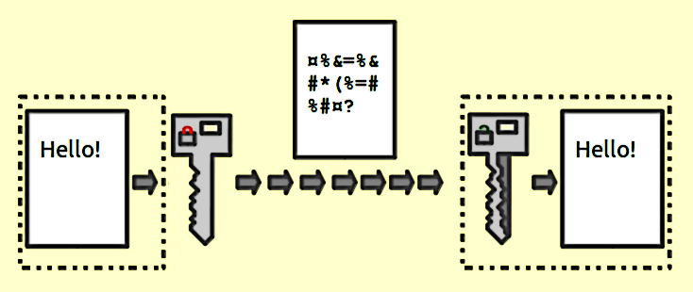
Encryption/ Decryption Method
Encryption/Decryption methods fall into two categories:
Symmetric key
Public key
Symmetric key algorithms: the encryption and decryption keys are known both to sender and receiver.
Public key algorithms: Encryption key is made public

Slide 53
Encryption
Properties of good encryption technique:
  Should be simple for authorized users to encrypt and decrypt data.
  Encryption technique should be able to encrypt the data by generating a the encryption key.
  Should be extremely difficult for an intruder to determine the encryption key.
Data Encryption:
  Convert the data into a secret message on the basis of an encryption key provided to authorized users.

Slide 54
Public-key Technique
Invented in 1976 by Whitfield Diffie and Martin Hellman. So also called Diffie-Hellman encryption.
Also called asymmetric encryption because it uses two keys instead of one key
Require two separate keys:
  One to encrypt the plaintext
  Other to decrypt the cipher text.
Neither key will do both functions.
One of these keys is published or public and the other is kept private.

Slide 55
Private key encryption
Symmetric encryption (also called private-key encryption or secret-key encryption) involves using the same key for encryption and decryption.
Encryption involves applying an operation (an algorithm) to the data to be encrypted using the private key to make them unintelligible.

Slide 56
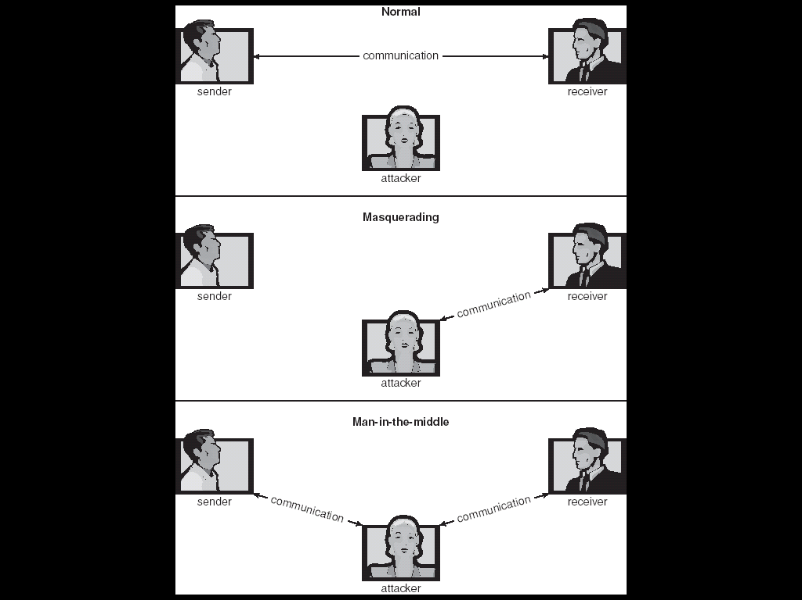
Communication

Slide 57
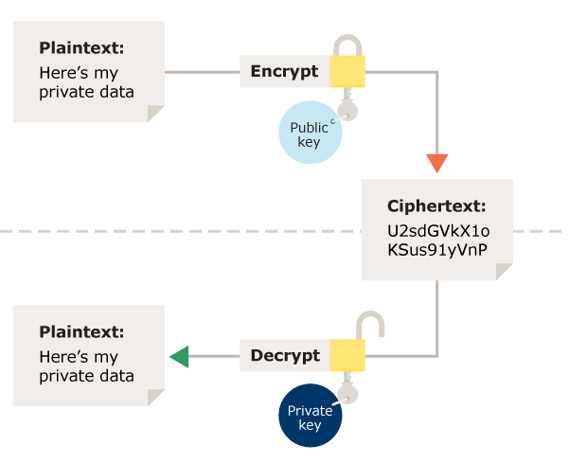
Encryption and Decryption using Keys

